Slide 1
Test Summary
Test management & Test techniques

Slide 2
Content
Recap of major topics
Test Management
Static testing
White-box testing / Black-box testing
Test Automation
Testable architecture & Unit testing
Usability testing
Talk about exam

Slide 3
Test management

Slide 4
What is testing?
Testing is much more than just run some tests and check their outputs.
Test planning
Test control
Test analysis
Test design
Test implementation & exectuion
Checking results
Evaluating exit criteria
Test results reporting
Test closure

Slide 5
Test Approach
The test approach is driven by the test objectives and the risk assessment.
Analytical, e.g. risk based or requirement based. Use of formal techniques
Process- or standard compliant, adopting external standards or process models
Regression-averse, reruns each time to make sure nothing has been broken
Dynamic, exploratory approach, low budget?
…

Slide 6
Test Plan
The plan typically contains a detailed understanding of what the eventual workflow will be. In software testing, a test plan gives detailed testing information regarding an upcoming testing effort, including Scope of testing. At the very least, it has to contain:
Schedule.
Test Deliverables.
Release Criteria.
Risks and Contingencies.
Notes:
Full plan:
Project Scope
The scope refers to the test project. Restate the business objective of the application and define the scope of the testing. The statement should be a list of activities that will be in scope or out of scope, such as different configurations, documentation to be reviewed. Example: as the application is used only internally, testing will be performed using only internet explorer.
Test Objectives
The test objectives provide a prioritized list of verification or validation objectives for the project. You use this list of objectives to measure testing progress, and verify that testing activity is consistent with project objectives. You should validate that the application correctly supports required business processes and transactions. You should verify that actions and data are available only to those users with correct authorization. You should verify that the system will support the required service levels of the business, example scale good enough.
Features and Functions to be Tested
Every feature and function must be listed for test inclusion or exclusion, along with a description of the exceptions. Some features may not be testable due to a lack of hardware or lack of control etc. The following is a basic list of functional areas: * Backup and recovery * Workflow * Interface design * Installation * Procedures (users, operational, installation) * Requirements and design * Messaging * Notifications * Error handling * System exceptions and third-party application faults
Testing Approach
The approach describe the levels and types of testing. The basic V-Model shows what types of tests that could be relevant to validate the system. More specific test types include performance testing, backup and recovery, security testing, environmental testing, conversion testing, usability testing, installation and regression testing. The specific testing methodology should be described and the entry/exit criteria for each phase noted.
Testing Process and Procedures
The order of test execution and the steps necessary to perform each type of test should be described in sufficient detail to provide clear input into the creation of test plans and test cases. Procedures should include how test data is created, and managed.
Test Compliance
Every level or phase of testing must have a defined set of entry/exit criteria which validates that a valid test have been performed. . The important point is that the test team must some how be able to determine when a test objective has been satisfied. One or more completion criteria must be specified for each test objective. The important consideration is that each requirement and how it is validated is documented. Test requirements are completely useless unless they can be satisfied. Testing Tools
All testing tools should be identified and their use, ownership and dependencies defined. The tools category includes manual tools, such as templates in spreadsheets and documents as well as automated tools for test management, defect tracking, regression testing and performance/load testing. Any specific skill sets should be identified and compared against the existing skills identified for the project to highlight any training needs.
Defect Resolution
A plan to address the resolution of failed tests needs to be created that lists the escalation procedures to seek correction and retest of the failed tests along with a risk mitigation plan for high-risk test. Defect tracking should include basic metrics for compliance based on number and type of defect found.
Roles and Responsibilities
A matrix listing the roles and responsibilities of everyone involved in the testing activities, along with the anticipated amount of their time allocated to the project, must be prepared.
Deliverables
All deliverables should be defined and their location specified. Common deliverables are test plans, test cases, test scripts, test matrix and a defect log.
Schedule
All testing activities should be combined into one master testing schedule. The schedule should include an estimate of time for each task and the dependences for each. Testing resources should be assigned to each task and quality gates should be listed to insure oversight of the entire process.
Environmental Needs
All the requirements of the testing environment need to be listed. Common ones include a description of the environment's use, management, hardware and software, specific tools needed, data loading and security requirements.
Resource Management
The skills of all personnel involved in the testing effort need to be assessed and the gaps noted so that a comprehensive training program can be designed. Specialty skills that will not be filled with in-house staff will require job descriptions and budgeting.
Risk and Contingencies
Planning for risk in advance and ways to mitigate it are essential for a robust strategy. A risk assessment that is prioritized by severity of risk and covers technology, resource, schedule and environmental issues should feed a detailed plan to mitigate each red flag.
Approvals and Workflow
All items on the critical path must go through an approval cycle. The procedures for approval and escalation must be well defined and assigned to resources prior to the start of the testing.

Slide 7
Test Phases
Design
Specifications/
Interactions
diagrams
Use- Cases /
System-events
Other requirements / Quality
Use-cases
Operation
Component
test
Performance
test
Integration test
System
test
Accept test
Installation
test / Live test
Components and modules
are integrated
Verified and
validated
system
Accepted
system
Full functional system with external interfaces
Component
test
Delivered system
in use
Components
are tested
Released from development
Test of operation
Notes:
Which brings us to the phases and how they relate.

Slide 8
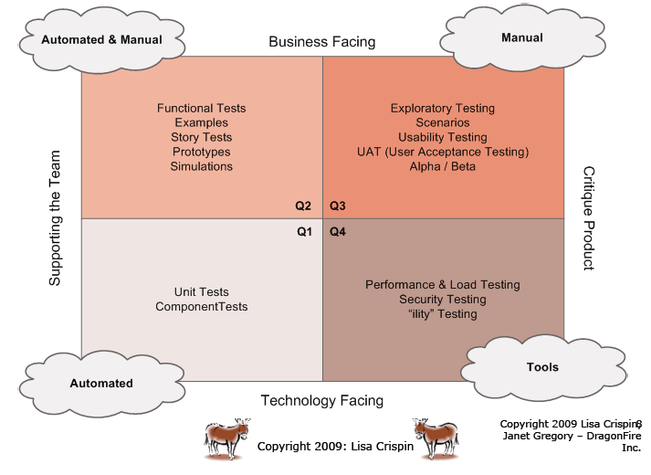
Agile Testing Quadrants The old test methods in a new context
The new context:
Story (or acceptance test) driven
development
The new context:
Test driven development

Slide 9
Traceability
The test plan is the scope, approach, resources, when to do what etc
Test Plan
The set of test conditions (anything that can be tested, such as requirements)
1
Traceability through ID’s. (As in database design)
1…n
Test Design
1…n
1…n
What happened:
The sequence of actions for execution of the test. Can be automated (script)
Test Case
What is expected:
Input values, preconditions, post conditions, expected results
1…n
1…n
Test Procedure

Slide 10
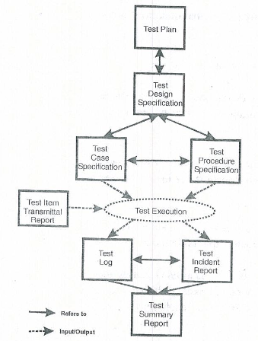
Example of documentation
IEEE 829
Test documentation
System releases etc.

Slide 11
Some commonly used stopping criteria
General advice: Use two stop criteria
We have met the coverage goals as defined in the test plan
The defect discovery rate has dropped below a previously defined threshold (see next slide)
The cost of finding the next defect exceeds the expected loss of that defect
The project team reaches consensus that it is appropriate to release the product
The Boss says ”ship it!”

Slide 12
Incidents & Bugs
Incident: Something unexpected has happened
Bug: We know for sure we have an error
You should be able to describe how an incident will become a bug and how you will know what part of your systems is affected (where in your code did the error happen?) and furthermore which requirements are affected by the bug.

Slide 13
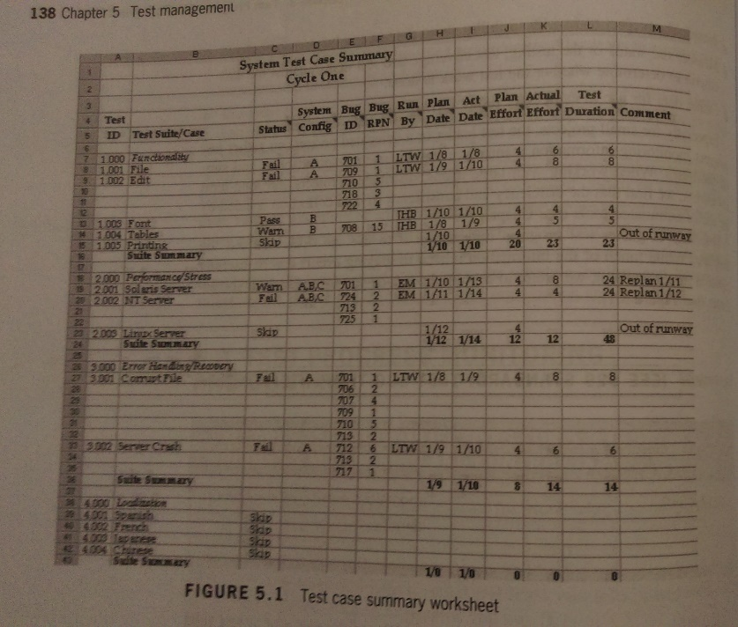
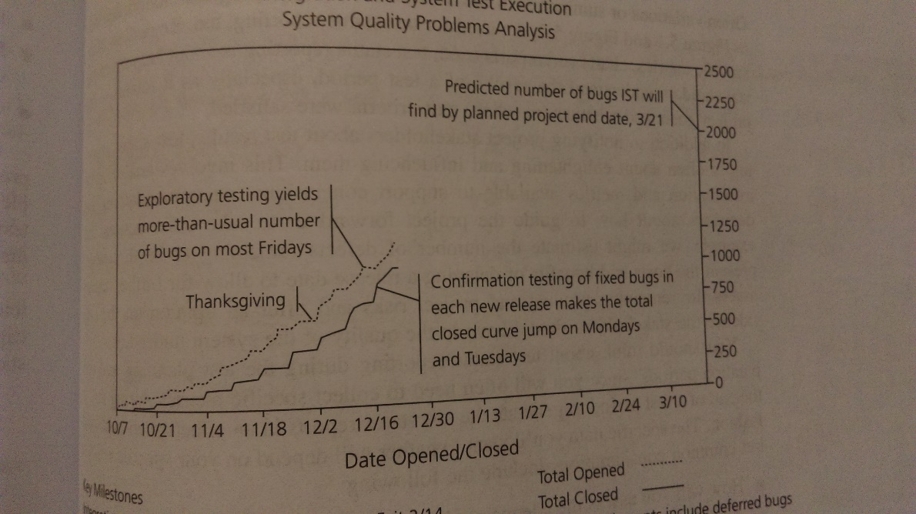
Test reporting

Slide 14
Lightweight table for product risk assessment
Product Risk | Likelihood | Impact | Risk priority | Mitigation
Risk 1
Risk 2
Risk 3
Risk n

Slide 15
Static Testing

Slide 16
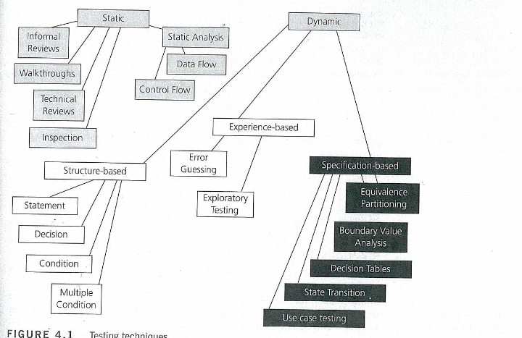
Static test techniques.

Slide 17
Benefits of static testing techniques
Are complementary and not opposing to dynamic testing techniques
Early feedback on quality issues.
Less rework costs means relatively cheap improvement of the quality (“Quality is free”)
The development productively increases
Sharing knowledge through the evaluation process
Increased awareness of quality issues

Slide 18
Formal review methods
Walkthrough
Author guides. Focus is gathering information and common understanding.
Technical review
A discussion based meeting. Focus on achieving consensus.
Inspection
The most formal review type. Focus on removing defects early and improving product quality.

Slide 20
Structure based vs static analysis
Different but with same taste
Static analysis
Is about analyzing the structural attributes of the code, is it too complex? Does the code conform to the code standards?
No execution of static analysis test is done on running code
Structure based test
Is used to assess that a wanted amount of coverage has (breadth) been achieved.
Used for generated additional test cases
Because the tests can only be executed on running code we categorize structure based tests as dynamic.

Slide 21
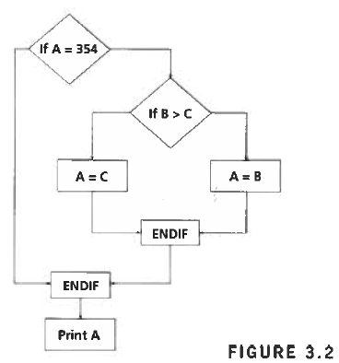
Control flow structure and code metrics
Code complexity metrics
(Cyclomatic complexity):
Or:
C = edges – nodes + 2(exits)
C = 8-7+2=3
C = p (binary decisions) + 1
C= 2 + 1 = 3
CC value | Type of flow | Risk
1-4 | Simple | Low
5-10 | Well structured and stable | Low
11-20 | More complex | Moderate
21-50 | Complex, alarming | High
>50 | Error-prone | Very high

Slide 22
Black box & white box testing

Slide 23
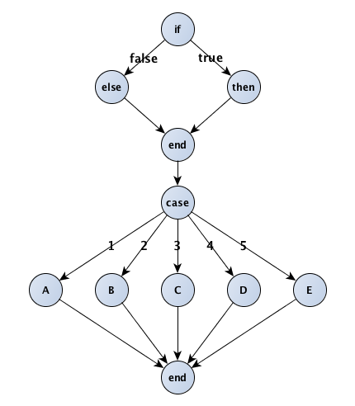
White box and black box
White box: Structure/path
Black box: Behaviour / Specification

Slide 24
Whitebox

Slide 25
Coverage For a Unit
Possible strategies
A code sample
Statement coverage
Decision coverage
Condition coverage
Paths
a=1
b=2
c=3
if (a==2)&&(b<2)
{n=n+2;}
else
{n=n/2;}
p=q/r
if (b/c>3)
{z=x+y;}

Slide 26
Black box

Slide 27
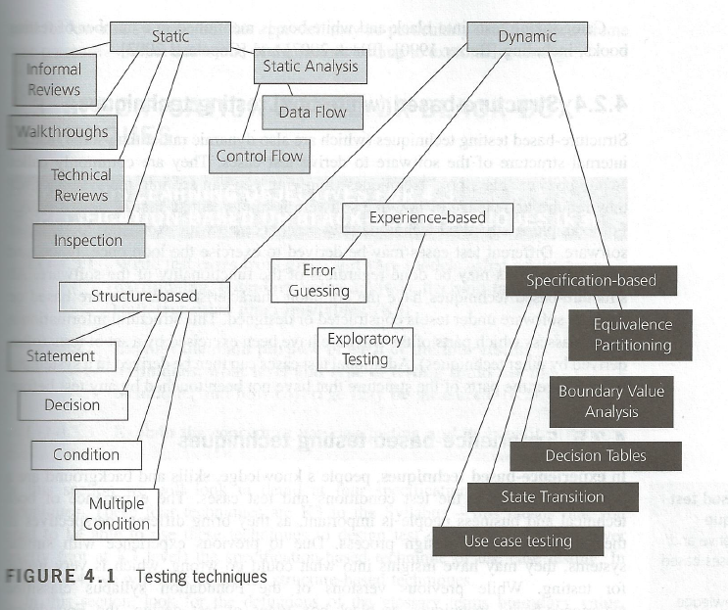
Test Design Techniques Overview
Source: ISTQB

Slide 28
Black Box at Different Levels
System
Unit
Subsystem
You don’t focus on the programming structure when you test – only input and output. Black box test can be conducted at all levels.

Slide 29
Equivalence Class Partitioning
The role of Equivalence Class Partitioning
Create the minimum number of black box tests needed while still providing adequate coverage
Steps
Identify equivalence classes – the input ranges which are treated the same by the software
Valid classes: legal input ranges
Invalid classes: illegal or out of range input values
Create a test case for each of the equivalence classes
Invalid
Valid
Invalid

Slide 30
Another Way to Annotate Partitions
999.99
1000.00 to 75,000.00
75,000.01
Invalid
Valid
Invalid
0
1 to 5
6
Invalid
Valid
Invalid
All Else
Condo, Townhouse, Single Family
Invalid
Valid
All Else
Person
Invalid
Valid

Slide 31
Boundary Value Testing (BV)
The role of Boundary Value Testing
An additional black box testing approach
Almost always used with Equivalence Partitioning
Test cases at the boundary of each input
Includes the following
At the boundary (where possible or if significant)
Just below the boundary
Just above the boundary

Slide 32
EP & BV
Invalid
Valid
Invalid
Equivalence Partition
Test
Equivalence Partition
Test
Equivalence Partition
Test
Boundary Value Tests
Boundary Value Tests
Note: The boundary test on the boundary should only be done if possible or significant

Slide 33
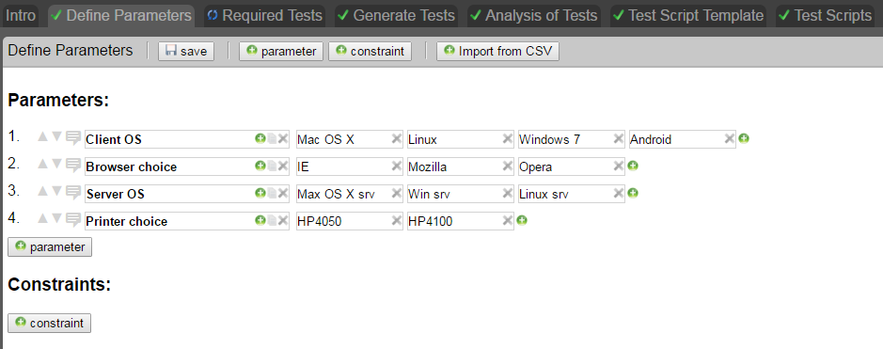
Combinatorial - All Pairs

Slide 34
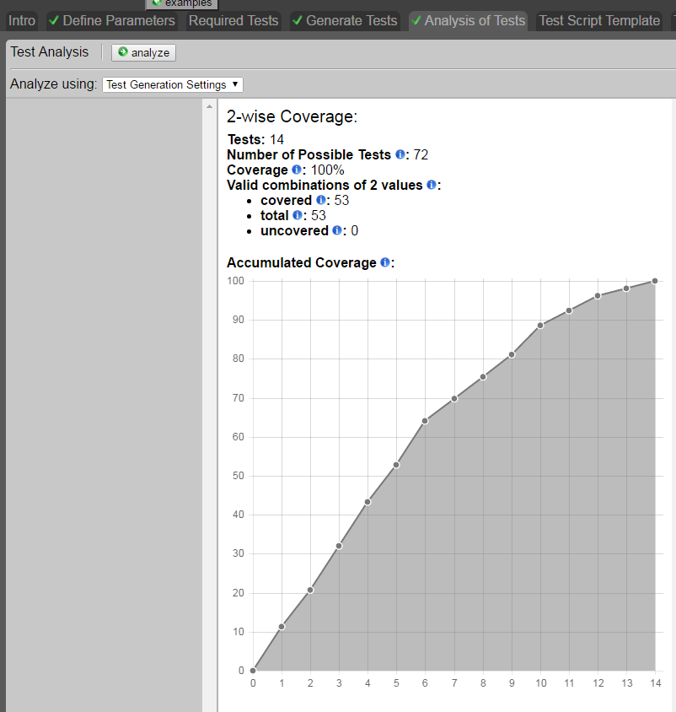
Combinatorial - All Pairs

Slide 35
Example Decision Table
From an automobile insurance company

Slide 36
Note
All black box tests should be traceable back to a specification.
Black box testing is also called specification based testing

Slide 37
Test Automation

Slide 38
Capture, Edit & Replay
User actions from GUI are captured and saved in the scripting language
Script is edited to manage different situations
The scripts are replayed
Results are verified by the script and/or manually

Slide 39
Data Driven Automation
Data file
Data driven script
Read Data Source
Conceptual model of a Data Driven Testing Flow
Read Data Source
Expected Result
Actual result
Compare
Source: http://www.ecanarys.com/blog-entry/data-driven-testing-selenium-webdriver-using-excel

Slide 40
Keyword Driven Automation
A simple keyword (one action on one object), e.g. entering a username into a text field:
A more complex keyword (a combination of other keywords in a meaningful unit), e.g. logging in:

Slide 41
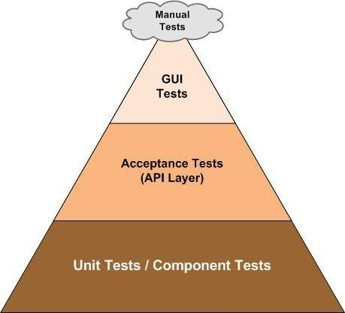
API vs GUI testing
API-layer test can also be done as keyword-driven or data-driven tests. And will in most cases be preferable.
Only consider GUI tests for GUI related concerns – like color of an element.
GUI level tests can also be relevant for legacy systems where you cannot access the API.

Slide 42
Architecture

Slide 43
An example
What is wrong with this piece of code?
public class Button { private Lamp lamp =
new Lamp(); public void Poll() { lamp.TurnOn(); } }
public class Lamp { public void TurnOn() { // turning lamp on... }
public void TurnOff() { // turning lamp off... } }

Slide 44
Inversion of control
public interface ISwitch { void TurnOn(); void TurnOff(); }
public class Button { private ISwitch switchableDevice; public Button(
ISwitch switchableDevice) { this.switchableDevice =
switchableDevice; }
public void Poll() { switchableDevice.TurnOn(); } }
public class Lamp: ISwitch { public void TurnOn() { // turning lamp on... } public void TurnOff() { // turning lamp off... } }

Slide 45
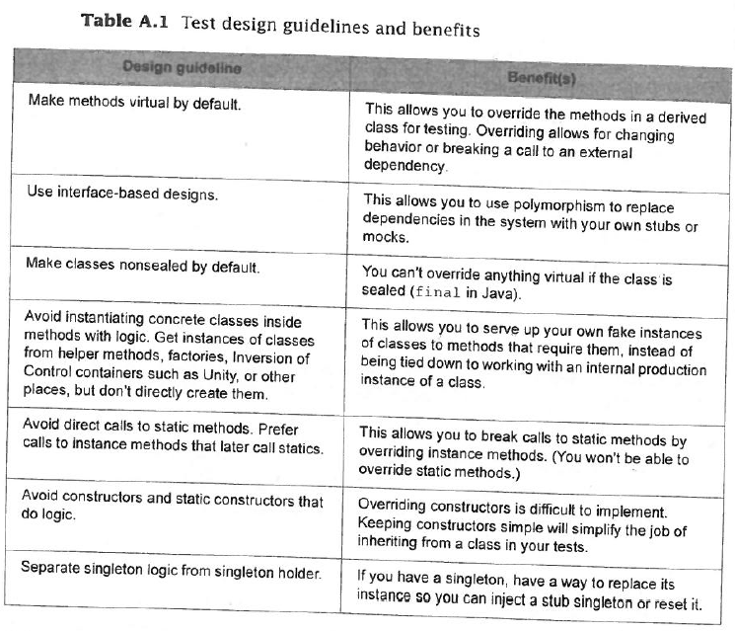
Architecture

Slide 46
Architecture
Inversion of control, factory patterns & dependency injection – Why?
Gives us the freedom to easily creates mocks and stubs.
What can we do with legacy code?
Use something like soapUI
Switch between production and test mode

Slide 47
Anatomy of good unit tests
Test only one thing (next slide)
Test isolation – tests do not depend upon other tests
Avoid logic – conditional statements and control flows
Avoid multiple asserts – if you have you might have multiple tests and your debugging might take longer
Give your tests good names

Slide 48
Test only one thing
https://msdn.microsoft.com/en-us/library/hh694602.aspx
//Arrange
Setup preconditions (might be method calls), and inputs
//Act
Only one method call to be tested
//Assert
Rule of thump: only one assert

Slide 49
Mocks & Stubs
Mock:
Is a fake object that decides whether the system has passed or failed.
Stub:
A controllable replacement for an existing dependency

Slide 50
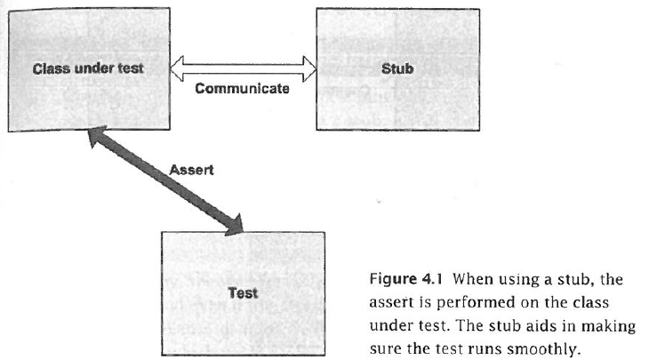
Stubs

Slide 51
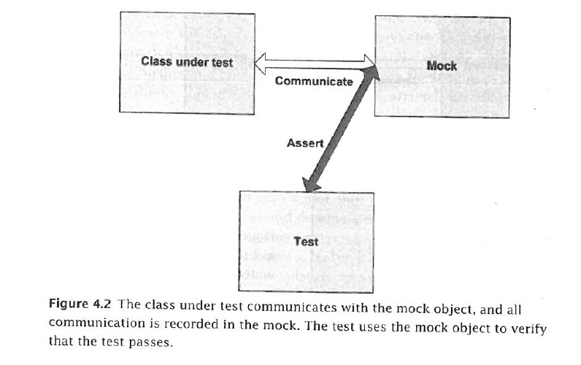
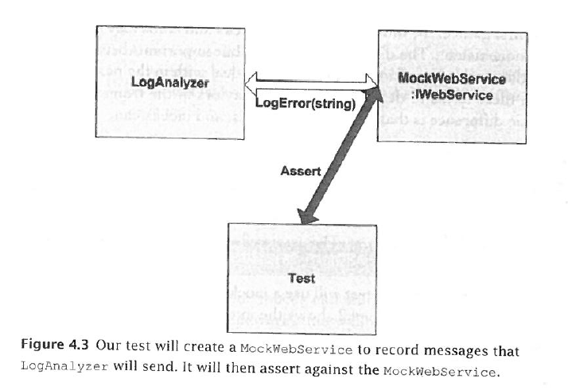
Mocks

Slide 52
Usability & Exploratory testing

Slide 53
Exploratory Testing
Basic steps to exploratory testing
Identify the purpose of the product
Identify functions
Identify areas of potential instability
Test each function and record problems
Design and record a consistency verification test

Slide 54
Usability testing techniques
The usability test techniques can be used at:
UI prototypes with different level of fidelity:
sketches, screen dumps, interactive UI prototypes that resemble the finished UI etc.
UI on executing systems
There is no distinction between static and dynamic testing, but between expert reviews and user testing

Slide 55
Usability testing techniques
Some formal review techniques:
Heuristic evaluation
Heuristic estimation
Cognitive walkthrough
Pluralistic walkthrough
etc.
User testing techniques
Think aloud
Focus group
etc.
We will focus on two techniques for usability testing

Slide 56
Create test tasks (think aloud)
The participants have to carry out a number of realistic tasks during the test session
The tasks must be based on the users need, cover the basic functionality and have a clear final
The requirement specification should be the basic for choosing the tasks, not the product (website)
A tasks list should be found in the test plan
Don't make too many so the most important are drowning in the mass
The first task should be easy
Both open and closed tasks
Typical problems
Vague and ambiguous
Broad and general
Gives too much help
Contains jargon are not users
Forces the user into a specific course
Coming in atypical sequence

Slide 57
Open and/or closed tasks
Open, not structured tasks (the possible solution are not provided in advance)
“Buy a bouquet of flowers for yourself and one for a friend”
The user decide the process -> great analytical work
Closed, structured tasks (predefined tasks in a specific order)
“Find a bouquet of flowers in the category: “Thanks”
“Place it in the shopping cart”
“Buy it”
“Fill in the forms with names, addresses, etc”
The possible solutions is limited -> easier to the analyze
Use a mixture!!

Slide 58
Exam

Slide 59
Exam guide from canvas:

